Slide 1


Slide 2
Design Sprint 2 | Team Split
 | DS2 Team 1 | DS2 Team 2 | DS2 Team 3 | DS2 Team 4
Design Sprint 1 (Bluster B & C: Online) Lead: Melalite | Bryan Waweru | James Macharia | Ronald Kudoyi | Katinka Harsanyi
 | Walela Masibo | Clementine Vandeleur | Brian Mwangi | Dmitry Spitsberg
 | Joyce Mbaya-Ikiao | Yixuan "Layla" Li | Job Dulo | Jennifer Mpho Lebethe
 | Benson Njuguna Kariuki | Fanen Acho | Alistair Gould | Nwachukwu Ossai
 | Kennedy Mukuna | Michael Denuh | Peter Kihara | Phillip Chele
 |  |  |  | Thabani Magubane
 | DS2 Team 5 | DS2 Team 6
Design Sprint 1 (Cluster A: In Person) Lead: Selam | David Lemayian | Sonali Sanghrajka
 | Simon Sondern | Ore Alemede
 | Mikul Shah | John Juma
 | Daniel Nordberg | Tracy Matia
 | Peng Chen | Ashish Patel
 | Jamie Pujara | David Njonjo

Slide 3

DESIGN SPRINT 2
B2B: SaaS & IoT

Slide 4
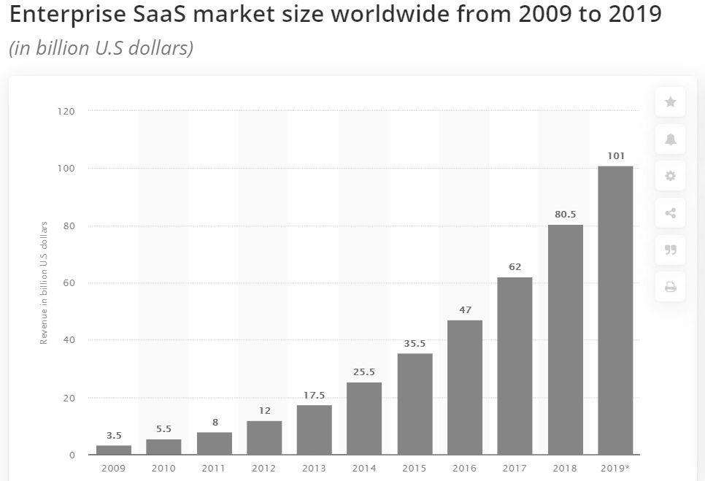
The global B2B SaaS market space is huge …
Source: Statista

Slide 5
… and full of gaps and opportunities
Category-defining enterprise software companies can emerge to solve problems for every vertical, every business size, and every job function. Three opportunity areas could be:
Making The Expensive Cheap: Because of the cost of traditional enterprise software, many categories of solutions were previously cost prohibitive for small or even medium sized businesses to benefit from.
The Next Billion Workers: Traditionally office-based knowledge workers have been the users of enterprise software. Mobile phones and tablets turn every type of employee – from the retail store associate to the field services team – into a knowledge/SaaS worker.
Digitizing Every Industry: Every industry is going through some form of information-based disruption; this is causing businesses to modernize their practices, leveraging new data, accelerating key processes, and delivering digitally-enabled experiences in the process.
Source: YCombinator Requests for Startups April 2020

Slide 6
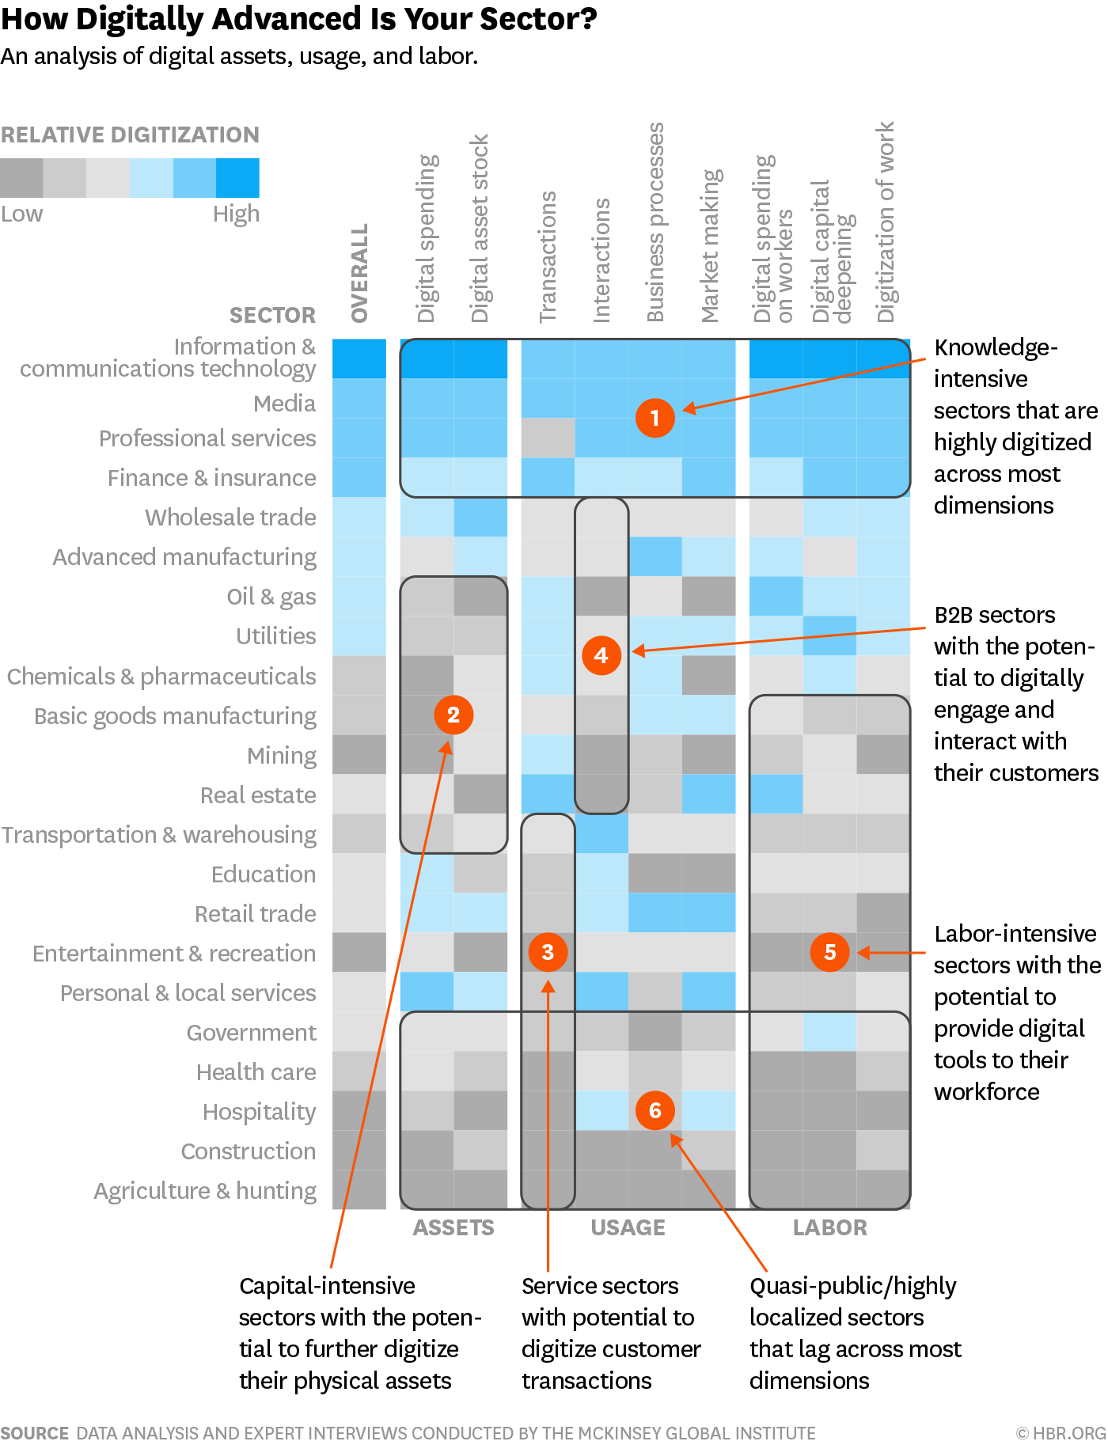

From “Ways to Innovate”:
What industries could be
exciting to transform?

Slide 7
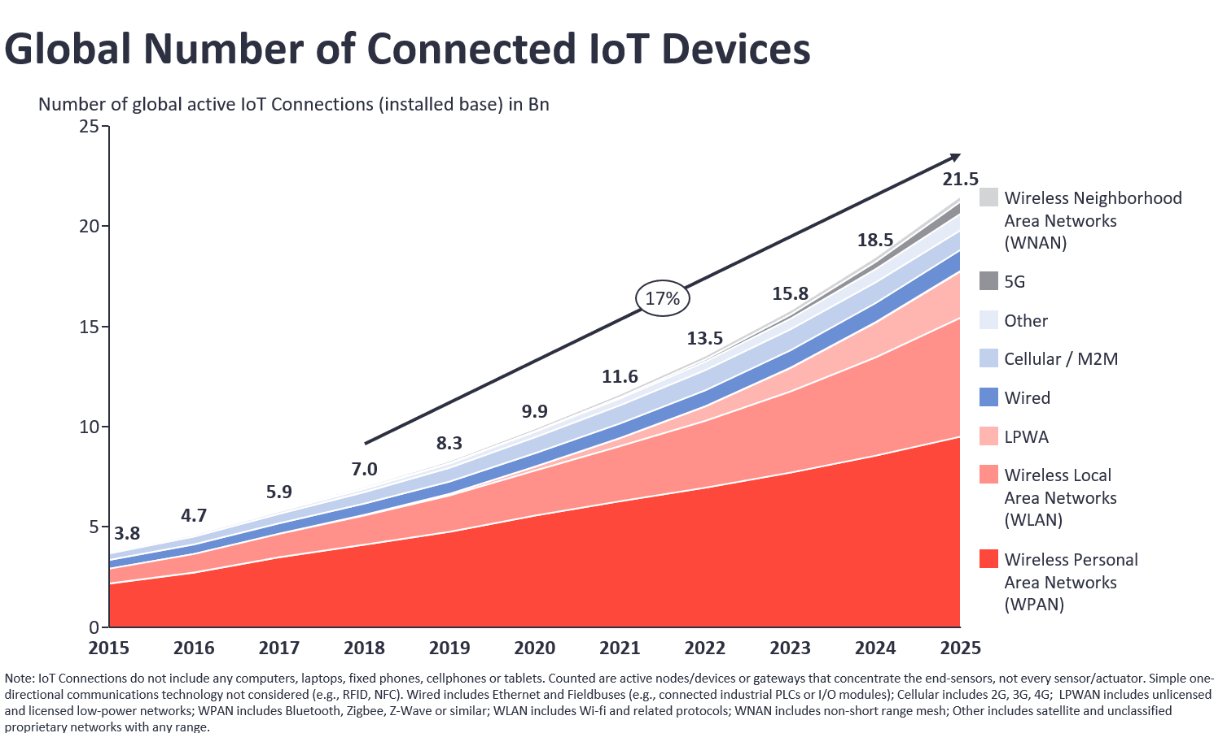
Meanwhile, the world is getting very connected ...
Source: IoT Analytics Research 2020

Slide 8

The internet of things, or IoT, is a system of interrelated computing devices, mechanical and digital machines, objects, animals or people that are provided with unique identifiers (UIDs) and the ability to transfer data over a network without requiring human-to-human or human-to-computer interaction.
Notes:
What exactly is IoT?

Slide 9
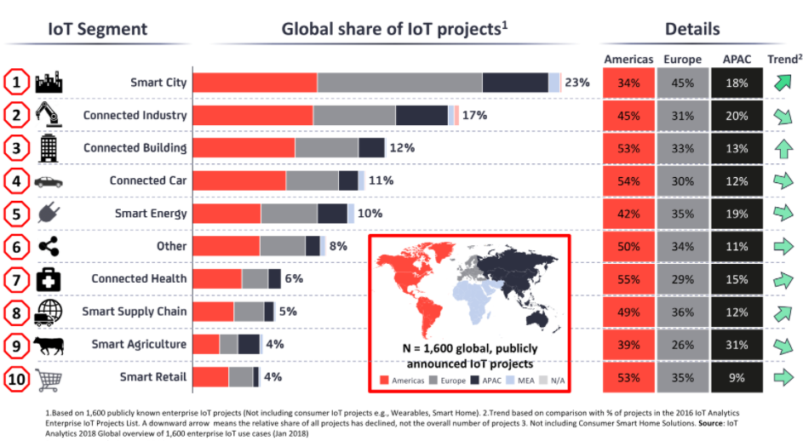
… and IoT is being applied across the board
Source: IoT Analytics Research 2020

Slide 10
Pick a problem in the B2B space that you find compelling, and think of solutions that can be addressed via
B2B SaaS and/or IoT

Slide 11



Your challenge!
Design a technology-driven solution that can solve a critical B2B problem …
Identify a B2B problem not solved well today...
...With an attractive
business model...
...that can
cost effectively scale

Slide 12


3 areas and questions to think about...
What problem are you solving?
What pain-point/problem is critical to solve?
Who is the problem relevant for (target customer)?
Would anyone be willing to pay for this issue to be solved?
What is your superior solution?
What does your solution/product look like?
What is your value proposition/selling point to consumers?
What is your moat?
Is the business financially viable?
How big is the market opportunity?
How will you commercialize your solution (business model)?
How will you cost effectively reach your target customer at scale?

Slide 13


We will review your end product in light of
Problem definition:
How big is the problem you identified?
How clearly defined is your target customer?
Solution, feasibility & competitiveness:
Would your solution effectively eliminate or reduce the problem?
How scalable is your solution?
Presentation:
Can you sell the core of your idea in a few simple slides?
Do you work as a team?

Slide 14
Timetable: Sept 10 & 11, 2020 (For Group B & C)
Thurs Sept 10
09:00 - 11:15
Masterclass: Problem Solving
Online
11:30 - 12:30
Getting your startup investment ready
13:30 - 13:10
Design Sprint 2 Introduction
13:10 - 17:15
Design Sprint 2 Working Session
Friday Sept 11
09:00 - 11:00
Masterclass : Go-to-market Archetypes
In Person
11:15 - 12:30
Africa & Emerging Markets Overview
13:30 - 17:15
Design Sprint 2 Working Session

Slide 15
Timetable: Sept 10 & 11, 2020 (For Group A)
Thurs Sept 10
09:00 - 11:15
Masterclass: Problem Solving
In Person
11:30 - 12:30
Getting your startup investment ready
13:30 - 13:10
Design Sprint 2 Introduction
13:10 - 17:15
Design Sprint 2 Working Session
Friday Sept 11
09:00 - 11:00
Masterclass : Go-to-market Archetypes
Online
11:15 - 12:30
Africa & Emerging Markets Overview
13:30 - 17:15
Design Sprint 2 Working Session

Slide 16

www.antler.co

